Slide 1
PRESENTATION TITLE
Home Loans Data Science Project
29/07/2023

Slide 2
TEXT LAYOUT 1
Agenda
Data Science Lifecycle
Project Overview
Process Overview
Data
Analysis
Modeling
Model Evaluation
Recommendations

Slide 3
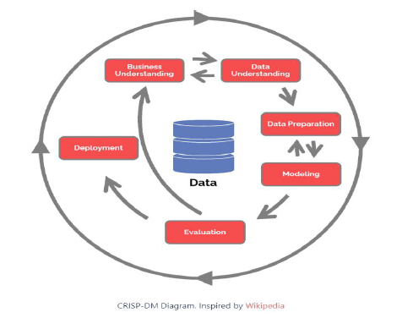
TEXT LAYOUT 1
Data Science Lifecycle

Slide 4
TEXT LAYOUT 1
Project Overview
Business Problem:
Currently the home loan application process is a manual one. It which takes 2-3 days, which mean
that the applicant will only be notified after 2-3 days of the application outcome.
Business Objective:
To Reduce the amount of time it takes for applicants to be notified about their loan statuses
Hypothesis:
We can use machine learning to predict the loan status of a potential borrower
such that the time taken for them to receive their respective statuses is reduced significantly.

Slide 5
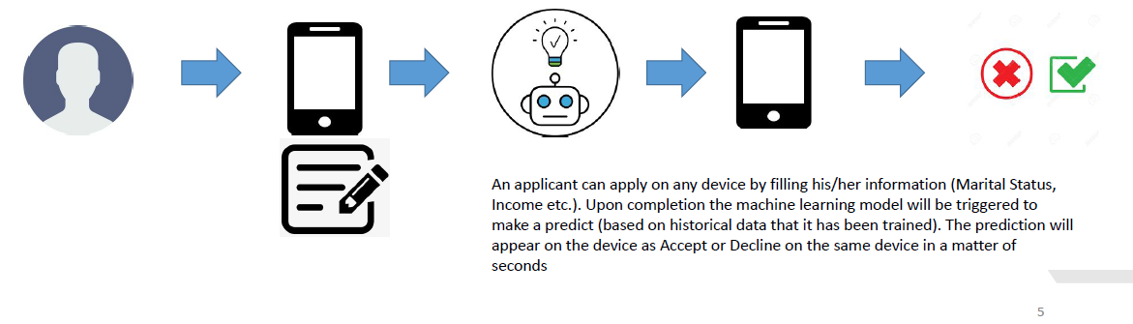
TEXT LAYOUT 1
Process Overview /Solution

Slide 6
TEXT LAYOUT 1
Data
The number of records – 614
The number of columns – 13
The number of numerical columns – 5
The number of categorical columns – 8
Target/Loan Status – Y (422) vs N (192)

Slide 7
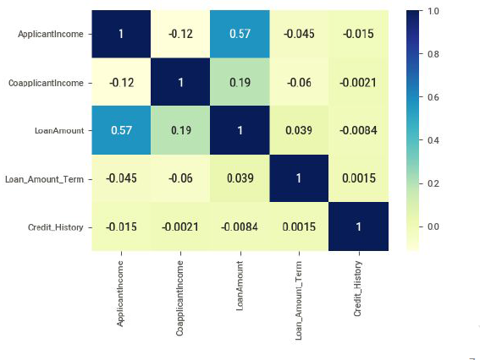
TEXT LAYOUT 1
Analysis

Slide 8
TEXT LAYOUT 1
Modeling
One machine learning model trained and AutoML used as well.
Bespoke model required preprocessing
AutoML did not
Results fairly similar

Slide 9
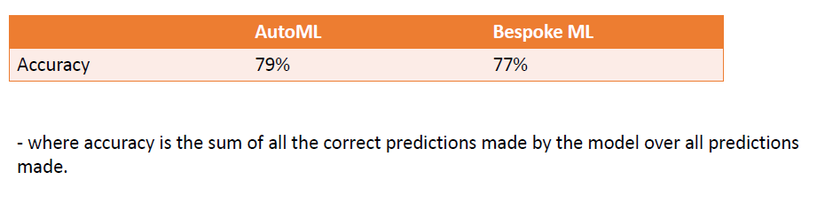
TEXT LAYOUT 1
Model Evaluation

Slide 10
TEXT LAYOUT 1
Recommendations
Bespoke ML > AutoML
We understand/know exactly what went in, how it went in and what algorithm was used to achieve the objective
Less time training (works in our favour if we train and predict in real time –maybe not applicable in this use case)
AutoML is best used as a baseline model.

